Slide 1
Sign Language Translation
Team: Amigos
Chandana Kolluru - 16338510
Rohan Kumar Bitukunti - 16338416

Slide 2
Motivation
Communication is the key components for interасtiоn between рeорle irrespective of the language. But in the case of Deaf and Mute people this becomes a barrier to communicate with the normal people.
We do have ASL (American Sign Language) which is used for the communication by the D&M people, but this doesn’t necessarily mean a normal person can understand and speak ASL.
If there is an interface which can convert the sign language to the text or speech and then speech to sign language then this helps for the D&M people in communicating with the non-D&M people.
The aim of the project is to develop Human Computer Interfасe (HСI) which will be user friendly, where the соmрuter understands the signs made by people and convert to text or speech and convert the speech of the normal people to sign language.

Slide 3
Significance
Communication with deaf or mute people can be a challenge in our society today because their communication method requires an interpreter at every instance.
This project helps in removing the language barrier constraint in communication between D&M people and normal people.
Converting the images of ASL to text as well as speech and at the same time converting speech to text and sign language can be a great help for those who can't hear or speak. This is especially true for the deaf/mute who needs it.

Slide 4
Objective:
Approximately more than half-million people in the US use sign language for the communication.
So the main objective of our project is to develop the user-friendly Human Computer Interface (HCI) which can help people translate text to sign language and sign language to text.
Since many people may not know the sign language(ASL) and it is difficult find the interpreters all the time , so we have come up with the real time model for replacing the interpreter with the HCI.
With this HCl use of interpreters for sign language will be reduced and many deaf and dumb people can communicate with a normal people with any barrier and lead a normal life.

Slide 5
Introduction
ASL is the mostly used by the Deaf and Mute people for the purpose of communication with other. Since D&M people cannot use spoken languages they also have different languages for the communication with are called sign languages .
People which are deaf and dumb make use of these hands to communicate their intentions and ideas without entering into spoken language.
Hence this project will be useful for both the normal people as well as dead and dumb people.
In project we can convert given signs (sign language) with the help of computer webcam to text and given speech to the sign language.

Slide 6
Methodology
The Signs of the ASL language are passed through the computer webcam with OpenCV and compare those signs with the pre-defined signs.
The dataset is divided into training and testing. In the training data we define the pre-defined sings for ASL language.
During testing when we pass the signs it matches and predicts the letter or word which the sign represents.
To convert text to sign language we pass the text through speech and match the text with the existing sings if they are present and give the output as gif.
If the given text do not have any gif in the data we have defined then we can get the output of signs as images for the text.

Slide 7
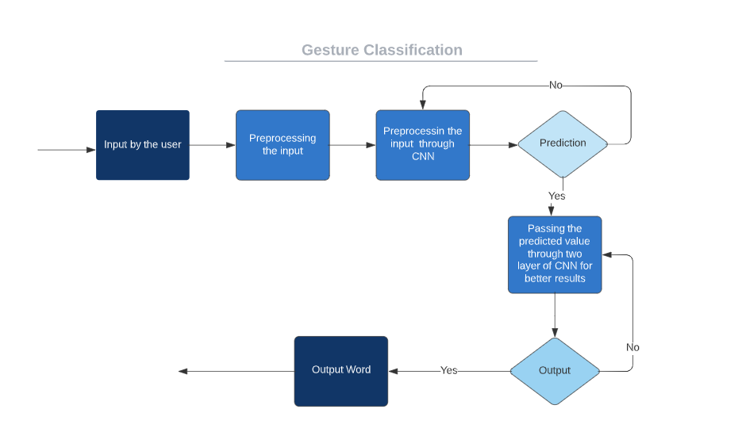
Workflow
Workflow to show conversion of sign language to text
Workflow diagram to show conversion of text to sign language
User input of text through speech
Process the input
Match the input text with the existing sings or gif from the data
Prediction
output
Pass the results to the used logic
Predicted output of signs

Slide 8
Software requirements
Python>=2.8
TensorFlow
OpenCV
NumPy
Matplotlib
Kera’s
Pyaudio
Pip win
Easygui
Tkinter
Speech recognition

Slide 9
Demo
Click here for the demo of the project.
https://docs.google.com/presentation/d/1JASF2x0STlk_8wqo6N0S_A2CNUvetZ-2/edit#slide=id.p1

Slide 10
Results
Using CNN algorithm, we were able to obtain an accuracy of 95.8% in converting sign to text. This accuracy is greater than that of the most of recent studies on American sign language.
Most of research the publications concentrate on using Kinect-like devices for hand detection.
Convolutional neural networks and Kinect are used to construct a Flemish sign language recognition system in, which achieves an error rate of 2.5%.
Using speech recognizer we are successfully able to convert speech to text and use the text to detect the gif from the data.
If the signs are present in the data we have predefined we are also able to predict the signs for each alphabet in the text.

Slide 11
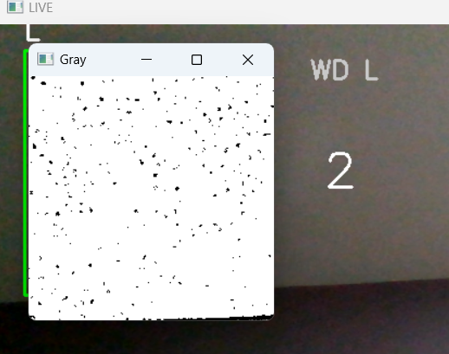
Results…(cont)
While converting the signs given by the user to the text , we have defined the background of the GUI to be white, so that the background noise does not influence our results.
We have collected the gif data from various sources and used them to get the results during translation of speech to signs.

Slide 12
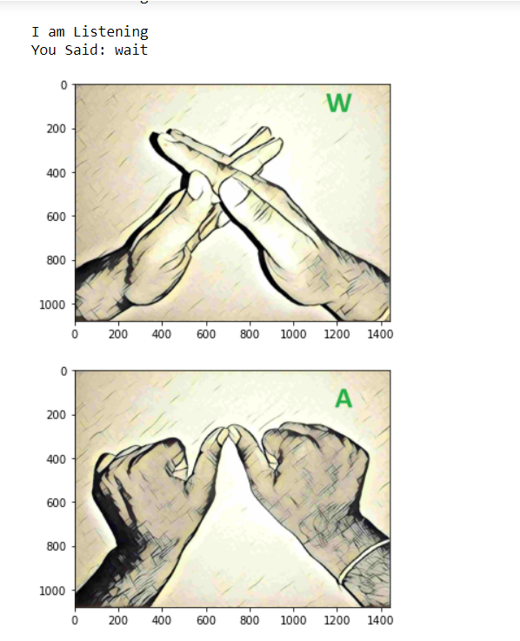
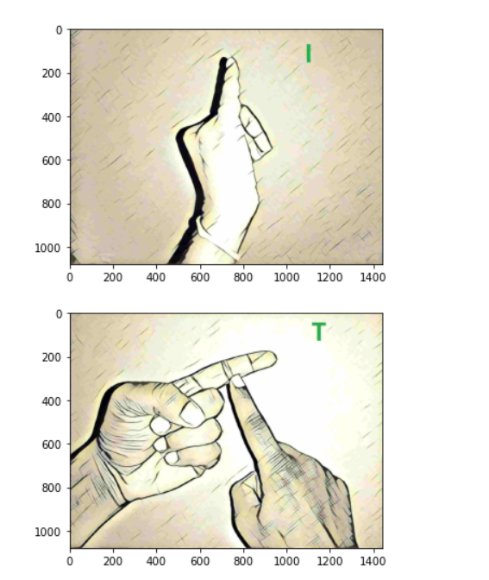
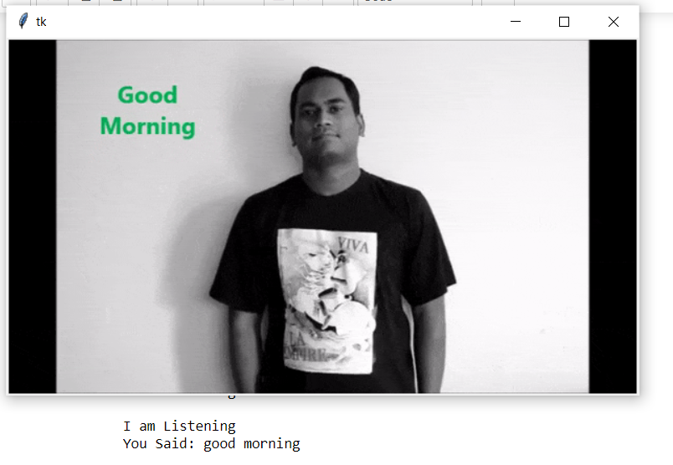
https://github.com/chandana341/Sign-language-to-text-speech

Slide 13
Challenges
The most difficult challenge we have faced is finding the pre-defined data set to convert signs to text. Since we were unable to find the data which satisfies our requirements then we have defined our own data.
Improving the accuracy of the classifier to the maximum has become one of the challenge even incase of a complex background or a background which has more noise.
While converting text to signs we have faced the problem with limited data for the gif signs.
The logic only gives the output if the given text is present in the pre-defined set of gif data else if just gives the signs of the alphabets in the text.

Slide 14
Future Works
Incase of complex backgrounds the prediction is less accurate when compared to plain background, so we are planning to build the model to give a greater accuracy in such cases for converting signs to text.
In the present model given signs can be converted to text and given input of speech is converted to text and then to gif signs but it is limited to only pre-defined data. In the future model we are planning to develop into an application which can do both translations simultaneously for all the data.
In the future model we can also plan to develop model for the individual user to create their own signs and store then and use then for conversation through model which would be unique for user.

